Slide 1
Talend Cloud
Talend Cloud Services are online services providing web-based interfaces through which you can access features and functions of the Talend Software to design, manage, and monitor integration capabilities.
Talend Cloud is a multi-tenant integration environment allowing you to design, manage, and monitor integration pipelines. Developers use Talend Studio (locally) to design data integration flows (or jobs) or Talend Pipeline Designer (a Talend Cloud app) to design data pipelines. Jobs and pipelines are then run in the Cloud or on-premises. The Talend Cloud infrastructure consists of the following applications as shown in the diagram on the following page: Talend Cloud, Talend Cloud Management Console, Talend Pipeline Designer, Talend Cloud Data Preparation, Talend Cloud Data Stewardship, Talend Cloud API Designer, Talend Cloud API Tester, and Talend Dictionary Service.
*Talend Cloud *
Talend Cloud is the web application that you access via your web browser on your desktop or mobile device, and it serves as the execution and communications platform to run Talend jobs. Talend Cloud runs as load-balanced application server instances on Amazon Web Services (AWS). After building a job it is executed on one or more “Cloud Engines” or “Remote Engines”.
• Cloud Engines are Java-based runtimes deployed via an Amazon Machine Image (AMI) based on Centos.
• Remote Engines are optional Java-based runtimes deployed by the customer to process data behind the firewall or on a Virtual Private Cloud (VPC), e.g. this can be on-premises or in third party clouds like Google, Azure or AWS.

Slide 2
*Talend Cloud Management Console*
Talend Cloud Management Console (TCMC) allows you to manage users, roles, groups, and projects for your Cloud applications, e.g. data integration, Data Preparation, Data Stewardship, Pipeline Designer.
*Talend Pipeline Designer*
Talend Pipeline Designer (TPD) is a Cloud app to design data integration pipelines in your browser and run in the Cloud or on premises.
• A pipeline is a data integration process (similar to a Talend Job) that extracts data from a dataset (source), transforms data using processors and loads data into one or several datasets (destinations).
• TPD stores input / output connectivity configuration into an inventory of connections and datasets that can be referenced in pipelines.
• Pipelines can be executed interactively in the application or scheduled in Talend Cloud Management Console.
• Pipeline executions are performed by a Remote Engine for Pipelines (hosted on-premises or a 3rd-party Cloud provider).
*Talend Cloud Data Preparation*
Talend Cloud Data Preparation (TCDP) is a self-service application that enables information workers to simplify and expedite the time-consuming process of preparing data for analysis or other data-driven tasks. In terms of naming, users create, update, delete and share datasets, and will create preparations on top of these datasets. Preparation executions can then be operationalized using Talend Studio.
*Talend Cloud Data Stewardship*
Talend Cloud Data Stewardship (TCDS) is a team-based, self-service data curation, arbitration and validation app where you quickly identify, manage, and resolve any data integrity issue.

Slide 3
*Talend Cloud API Designer*
Talend Cloud API Designer (TCAD) is an application that provides visual design and team collaboration tools for defining a contract-first API with consumers. “Live preview” makes it easy to simulate an API, which can be deployed to popular API gateways for load balancing and mediation. Documentation is automatically generated facilitating API use by others. It is deployed as a web application.
*Talend Cloud API Tester*
Talend Cloud API Tester (TCAT) is a visual tool to discover and debug APIs. You can easily create tests and run scenarios composed of many API requests to simulate real-life usage. Unit tests can be integrated into a managed CI/CD process, ensuring consistent quality.
*Talend Dictionary Service*
The Talend Dictionary Service is used to define and manage semantic data types for Talend Cloud Data Preparation and Talend Cloud Data Stewardship. There are two Dictionary Service components: Data Quality (DQ) Dictionary Server and Data Quality (DQ) Dictionary Consumer.
DQ Dictionary Server: Semantic data types can be created, modified, deleted in a dedicated web user interface. Any change is stored in Talend Cloud.
DQ Dictionary Consumer: When modifications are "published", they are propagated from the DQ Dictionary Server to client applications (i.e. TCDP/TCDS) via Apache Kafka events. The client applications rely on a DQ Library that manages these events. The DQ Library creates and maintains a local Apache Lucene copy of the semantic types, so that TCDP/TCDS can perform semantic type discovery and data validation.

Slide 4
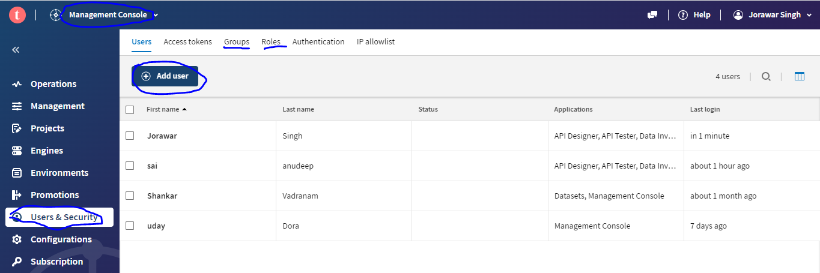
Creating Users and Roles in Talend Cloud
You can use Talend Management Console to:
Create roles, users, and user groups
Create projects
Check available licenses
Govern and manage tasks
Monitor task execution

Slide 5
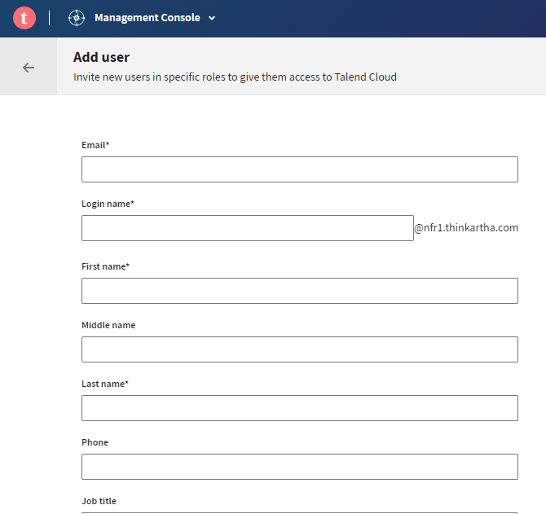
#Talend cloud sends a email and activate the login
#Login to your created user.

Slide 6
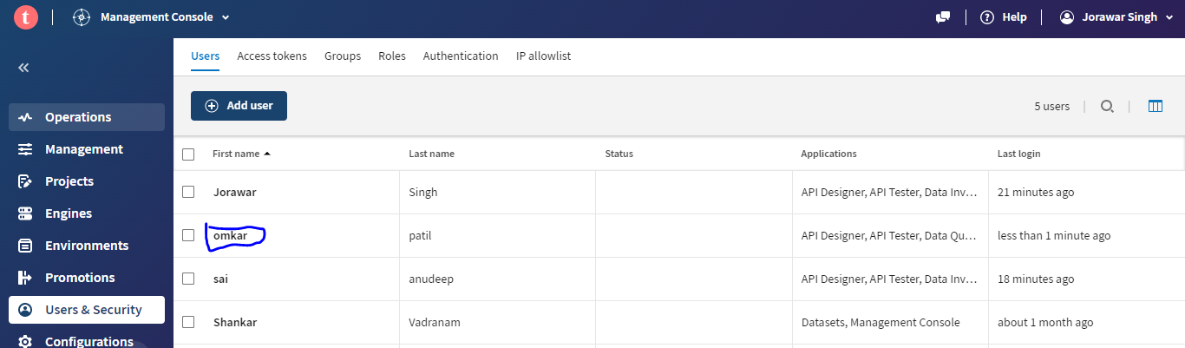

Slide 7
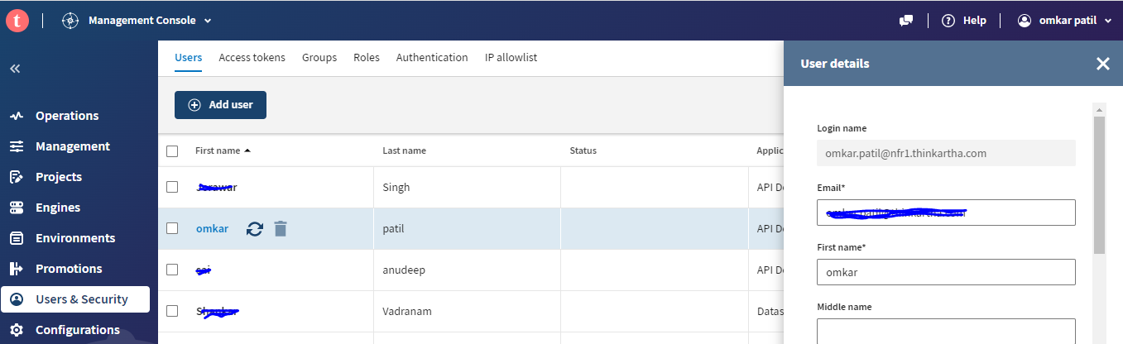
*Talend cloud connected to Talend studio and publish the job*
Open the Talend studio.
Manage connections.
Username created in Talend cloud.
Copy paste the personal access token from talend cloud.
Check the connection.

Slide 8
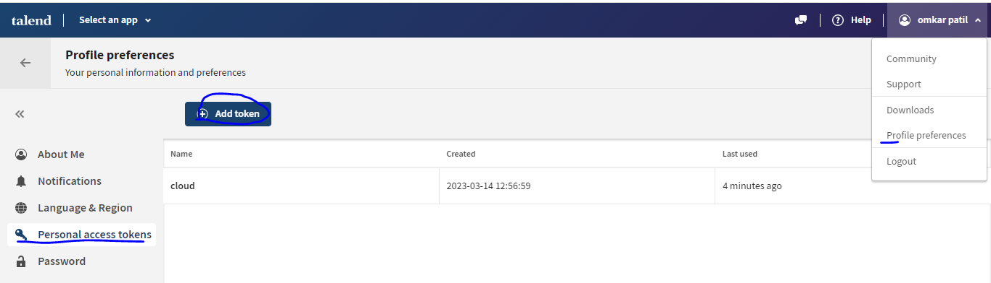
#Goto talend cloud
Create the project
Add the git url in the project.

Slide 9
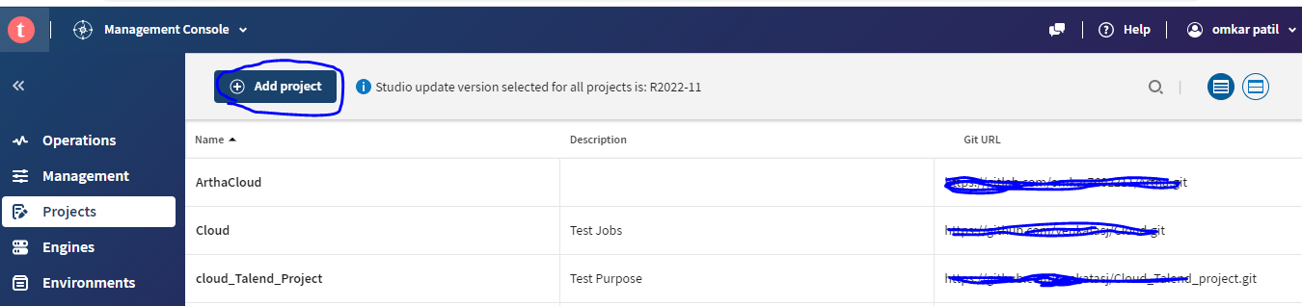
#Goto talend cloud
Create the project
Add the git url in the project.

Slide 10
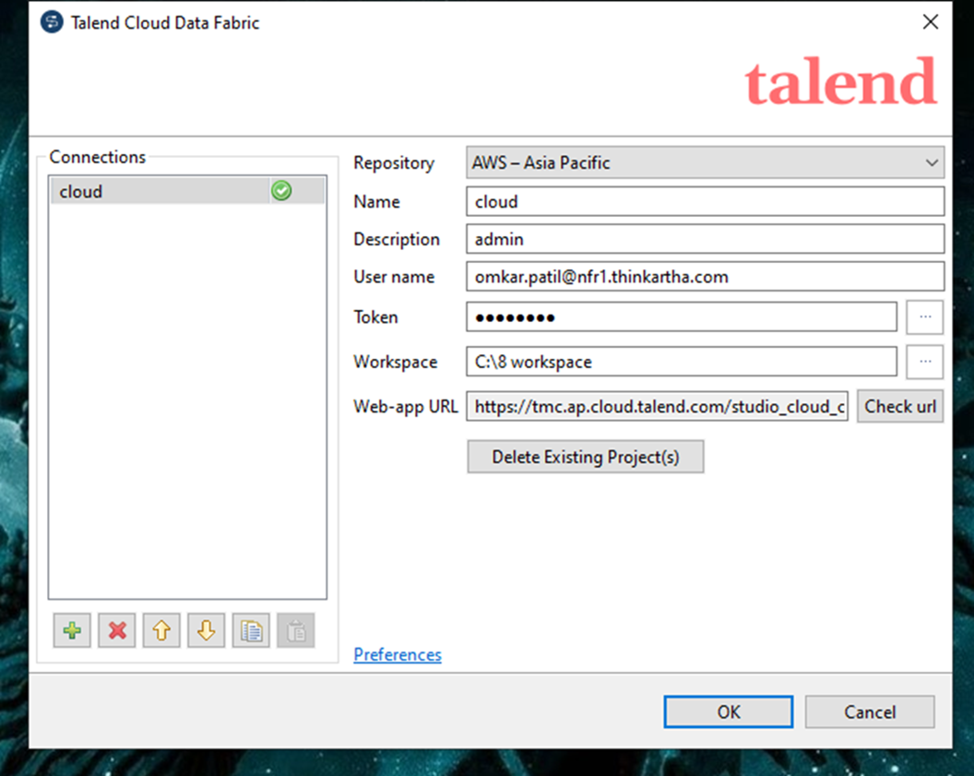
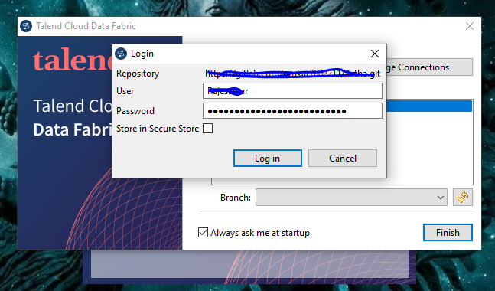
#Goto talend studio
Add the git Username
Add the token of the git.

Slide 11
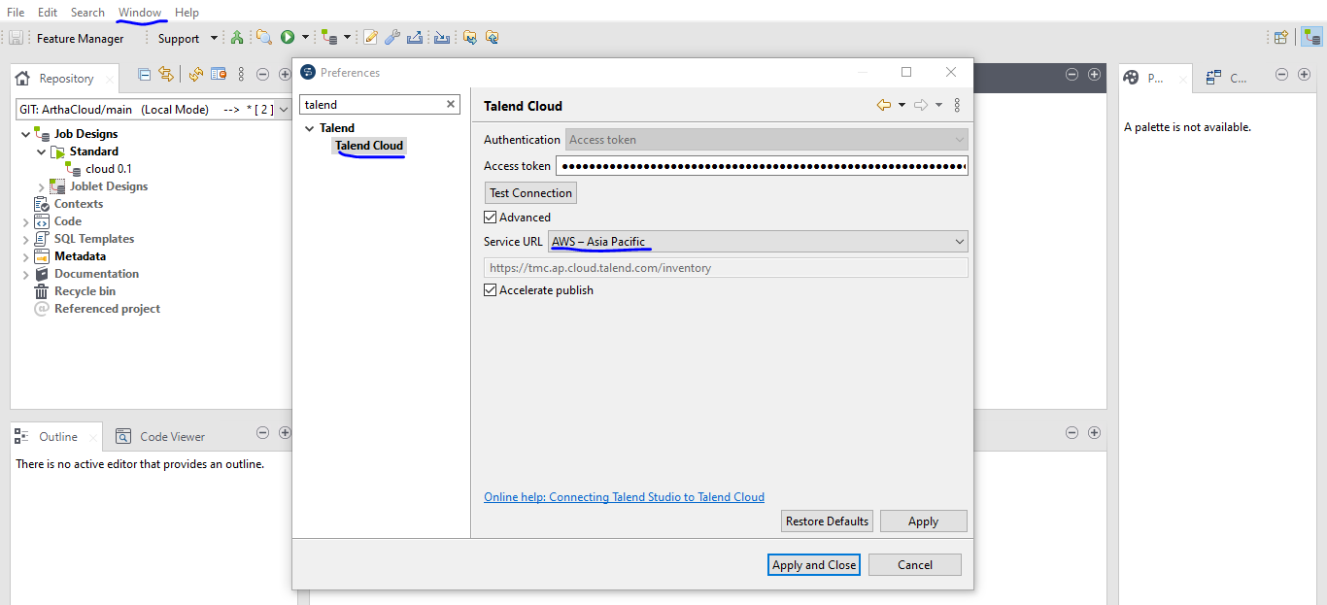
#Goto talend studio
Create a job
Windows >preferences> talendcloud
give the token of talend cloud and connect
iii) Right click on job downside publish to cloud.
publish the job to cloud

Slide 12
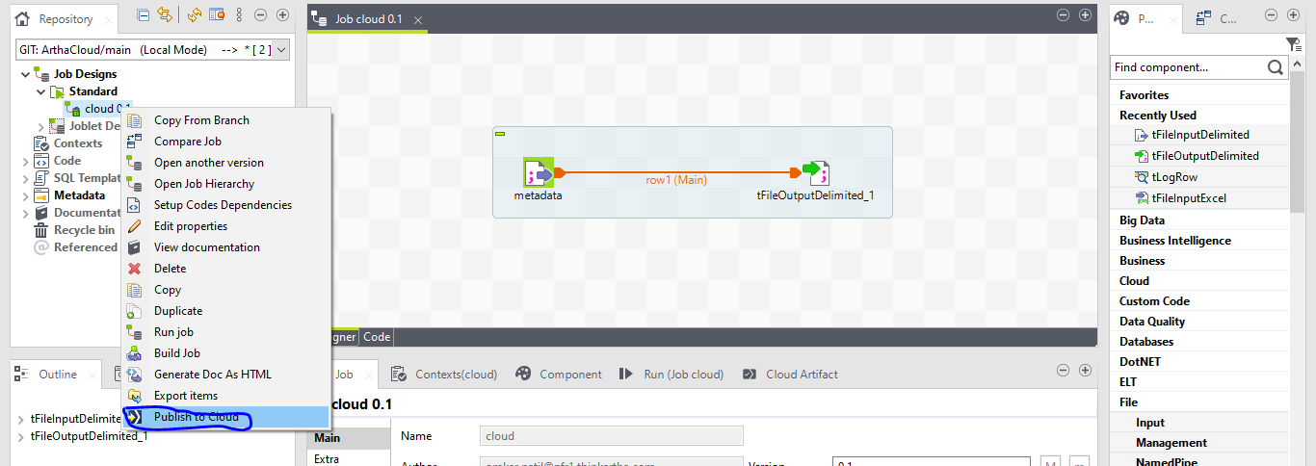

Slide 13
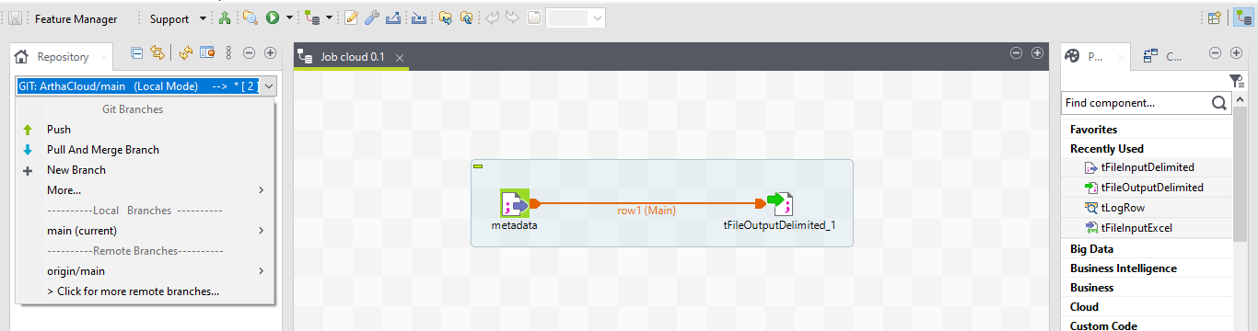
Git configurations

Slide 14
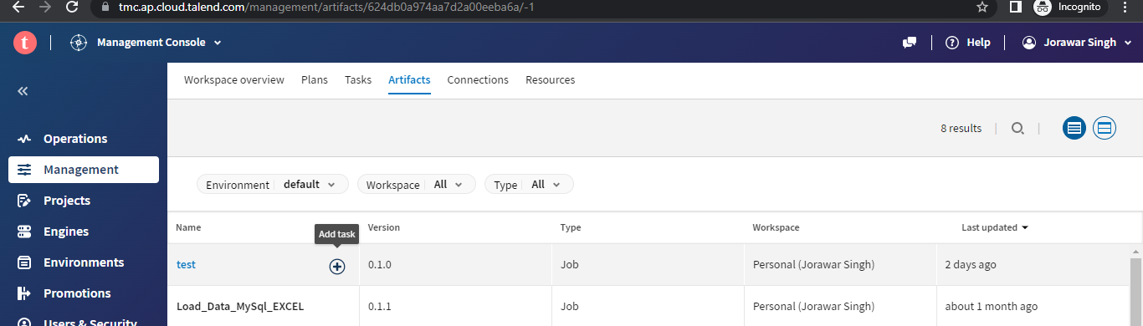
#goto talend cloud
i)Talend managemaent console.
ii)Artifact.
iii)Add task
iv)Give configuration
v)Goto tasks
vi)Run
vii)Check the logs

Slide 15
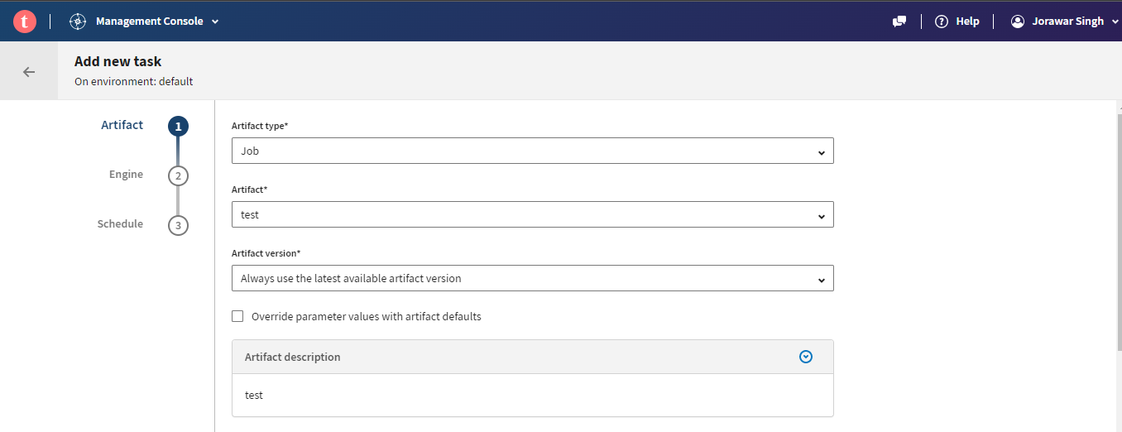
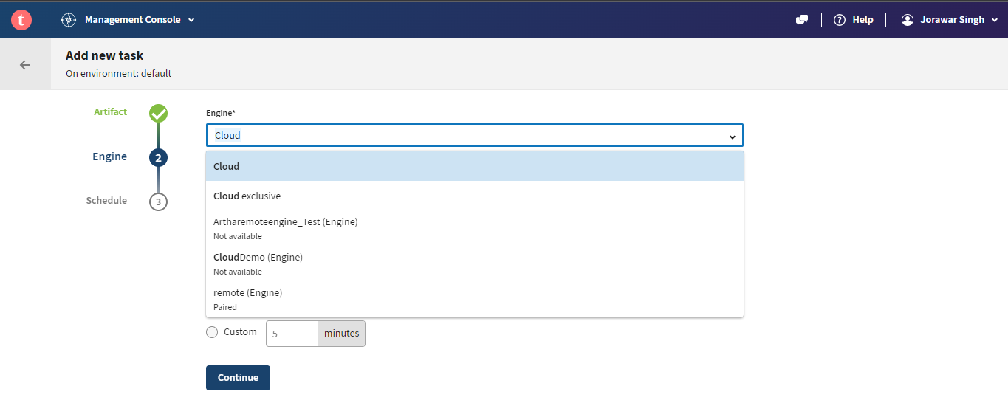

Slide 16
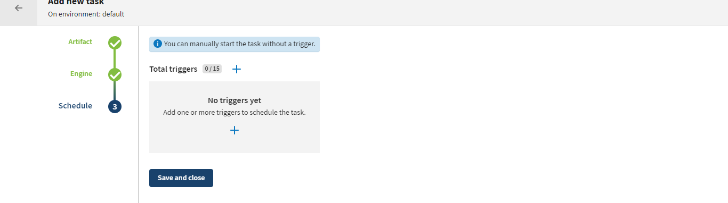
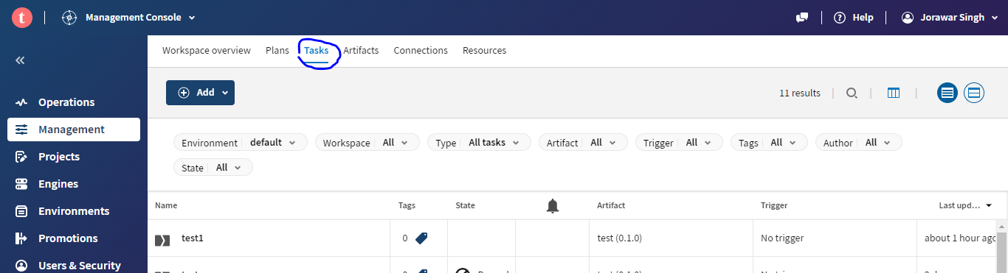

Slide 17
